Slide 1

Mid Evaluation
Full Stack Trainee
Internal Guide External Guide
Prof. Dipika Bavaliya Mr. Suresh Prajapati
Presented By :
Aditya Dharmeshbhai Patel (200320132006)

Slide 2
Company Details
Ahmedabad-based Hyperlink Infosystem is believed to be one of the popular providers of IT services. The professional company is closely structured in such a way to offer more acquirable results and solutions for use in a variety of businesses, encountering problems in information and technology sector.
Company Address
Hyperlink Infosystem
Ganesh Meridian, BLOCK-C, Opp Gujarat high court, 106/B, Sarkhej - Gandhinagar Hwy, Sola, Ahmedabad, Gujarat 380061

Slide 3
Internship Summary
I, the trainee intern of “Full Stack Developer”, with immense pleasure and commitment would like to present the internship work. The implementation of all the tasks has given me wide opportunities to think, implement and interact with various aspects of the new emerging technologies in the area of web development. Every work that one completes successfully stands on the constant encouragement, goodwill, and support of the people around.

Slide 4
AIMS AND OBJECTIVES
AIMS
OBJECTIVES
The aim of the 8-week internship was to participate in a comprehensive introduction to modern web development with foundational skills and practical experience to enhance the skills.
In this 8-week internship, my primary objective is to develop a solid foundation in web development. Through hands-on exercises and guided projects, and to impart practical skills in building interactive user interfaces and implementing responsive designs.

Slide 5
TOOLS AND TECHNOLOGIES
HTML
CSS
Javascript
jQuery
Bootstrap
Hyper Text Markup Language (HTML) is the set of markup symbols or codes inserted into a file intended for display on the Internet. The markup tells web browsers how to display a web page's words and image.
CSS is a rule-based language — you define the rules by specifying groups of styles that should be applied to particular elements or groups of elements on your web page.
JavaScript is a scripting language that enables you to create dynamically updating content, control multimedia, animate images, and pretty much everything else.
jQuery is a JavaScript Library. jQuery greatly simplifies JavaScript programming. jQuery is easy to learn. jQuery is a lightweight, "write less, do more", JavaScript library.
BootStrap version 5 is a HTML Framework that helps in Building fast, responsive sites with Bootstrap Powerful, extensible, and feature-packed frontend toolkit.

Slide 6
Functional
OTHER ASPECTS
Outcomes
Apply basic programming principles to the construction of websites. Effectively manage website projects using available resources. Demonstrate communication skills, service management skills, and presentation skills.
Visual Elements
Navigation : Navigation simply means the process of monitoring and controlling the movement around websites or screens, etc.
User Interaction : The user interface is very important as it will either make and increase visitors to your website or break the user base
Performance : Loading Page, Rendering Page, Responsiveness.
Layout : Layout simply represents the overall structure of the website that includes graphics, ads, texts, headers, menus, content, etc..

Slide 7
NOW LET’S SEE SOME OF THE TASKS THAT I DID DURING INTERNSHIP :

Slide 8
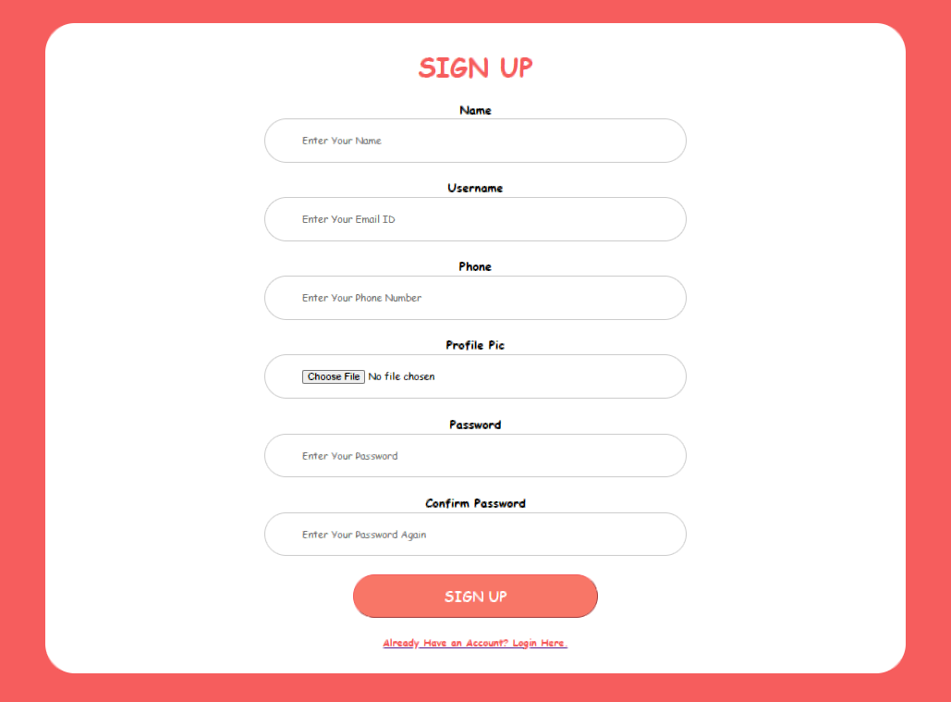
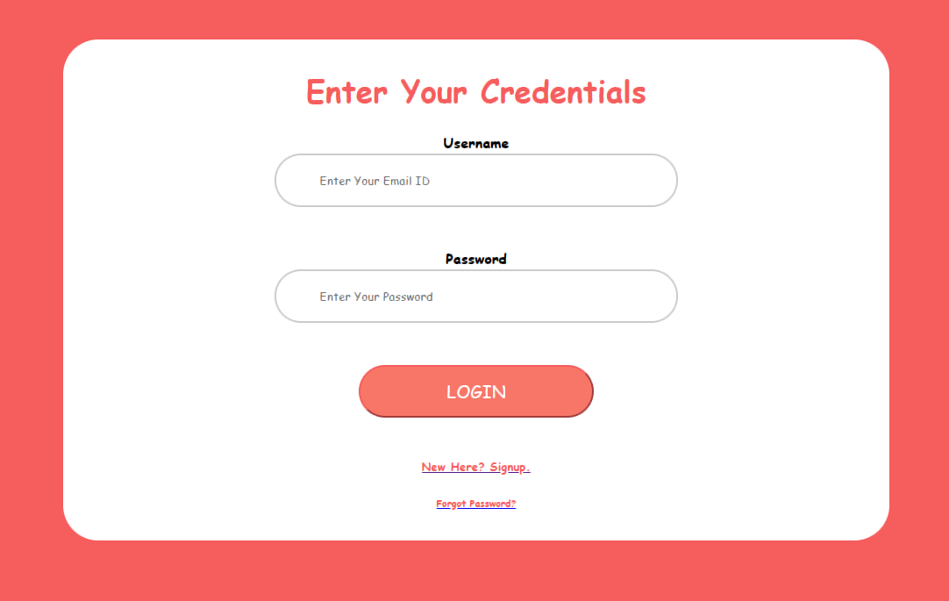
1st WEEK TASKS ( 18th JAN to 20th JAN )
18th January 2024 : First day of the company, so just an introduction to the company with goodies and also connecting with some new people.
19th January 2024 : Second day of the company, so just a basic task based on HTML CSS, as you can see on both left and right: the login form and signup form.

Slide 9
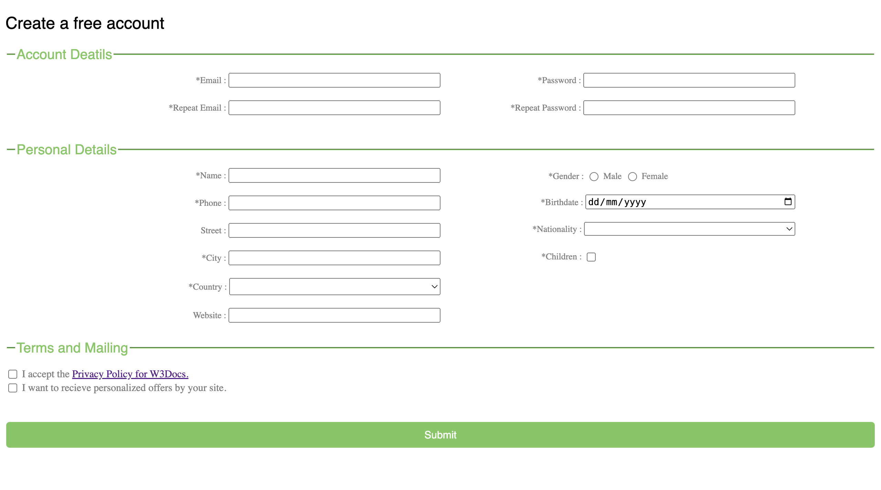
20th Jan Task
On this day, as shown on the left side, a simple login form template is given, and on that basis, we have to create the login form that looks like that template.

Slide 10
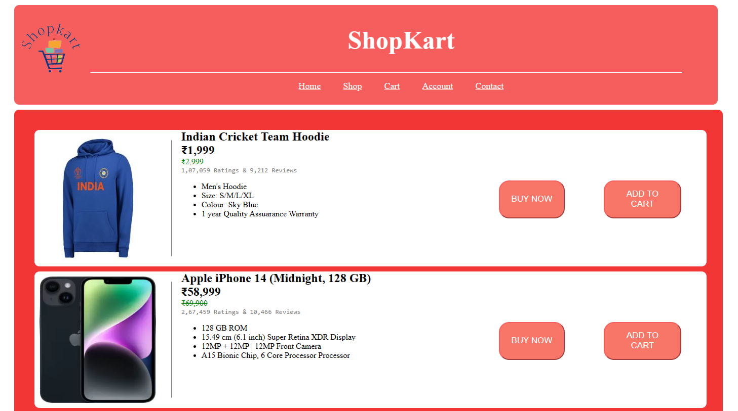
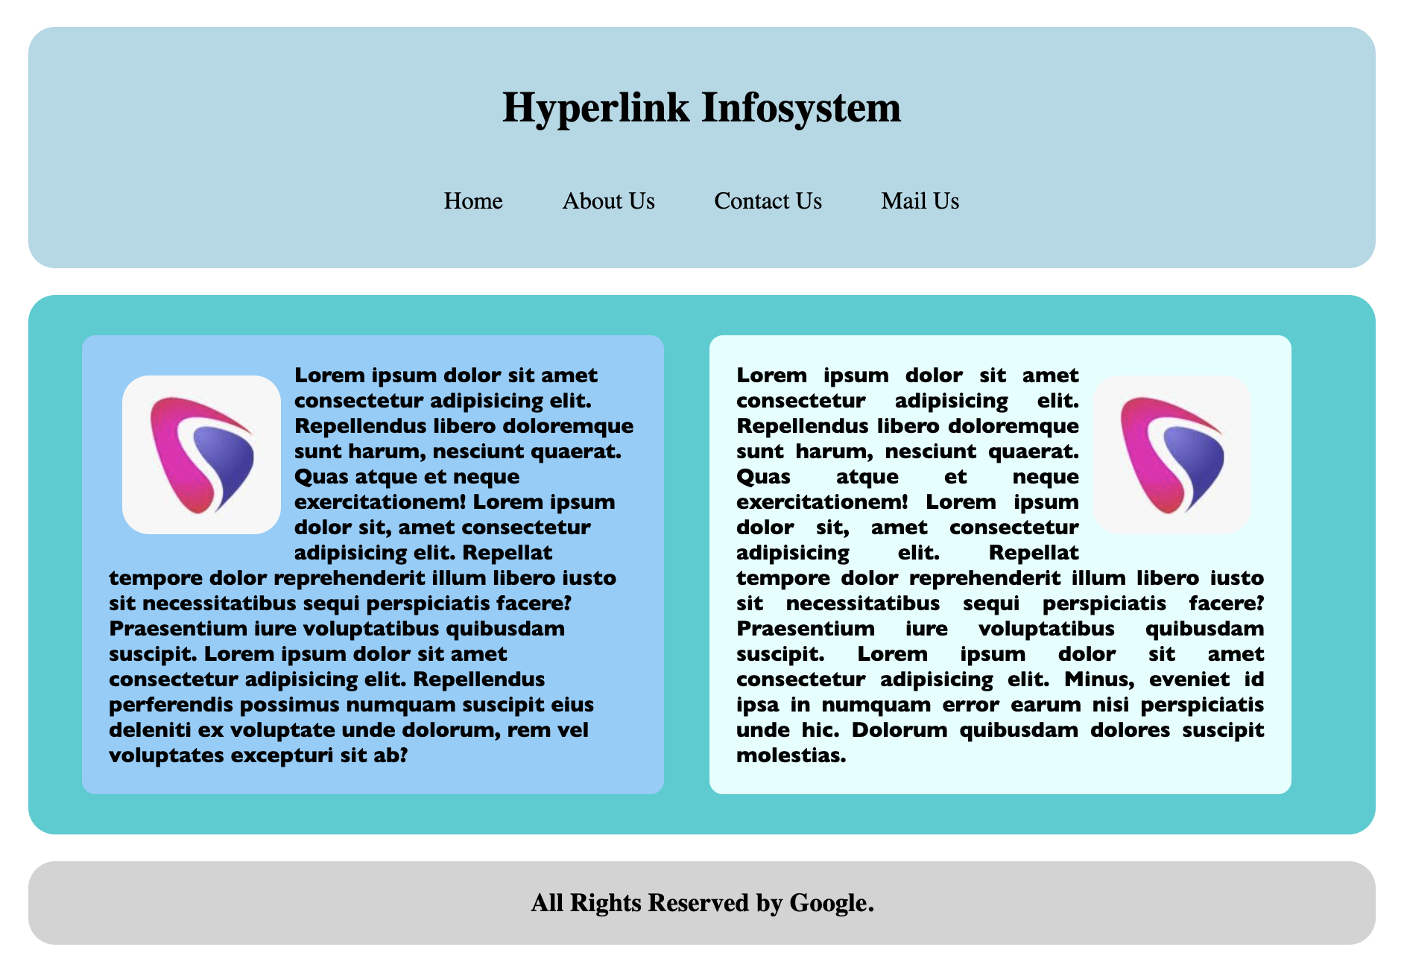
2nd WEEK TASKS ( 22nd JAN to 23rd JAN )
22nd January 2024 : As you can see in the image of the output on the left upper side, you can see that the elements are differentiated through margin and padding. So that day, margin and padding were taught.
23rd January 2024 : On this day, we learned about the hovering effect with the adjustment of the image paragraph using the display, justify content, and many more properties.So the output of that is at the right bottom.

Slide 11
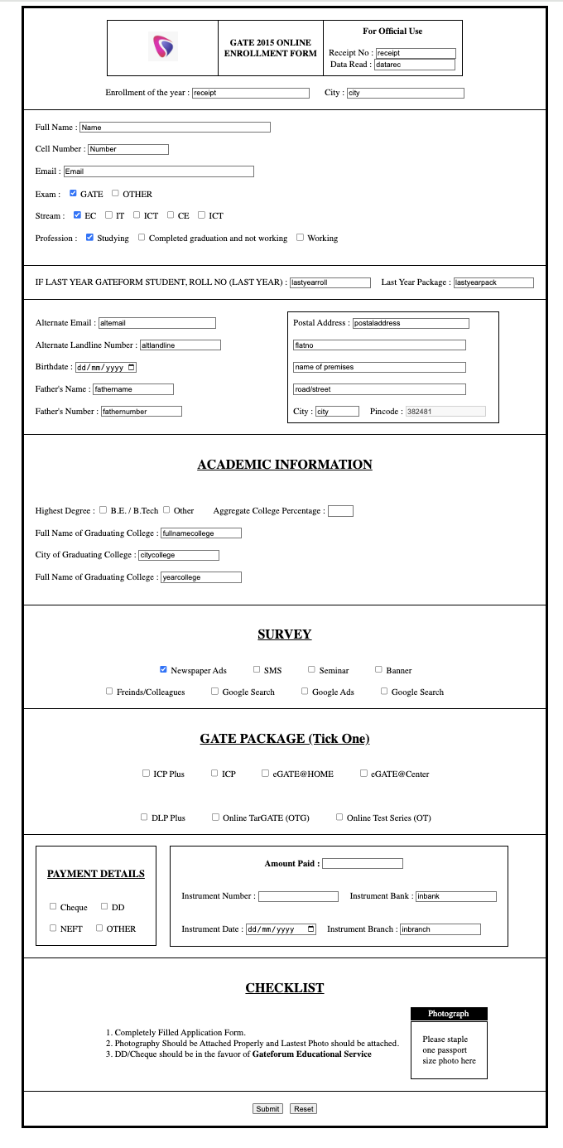
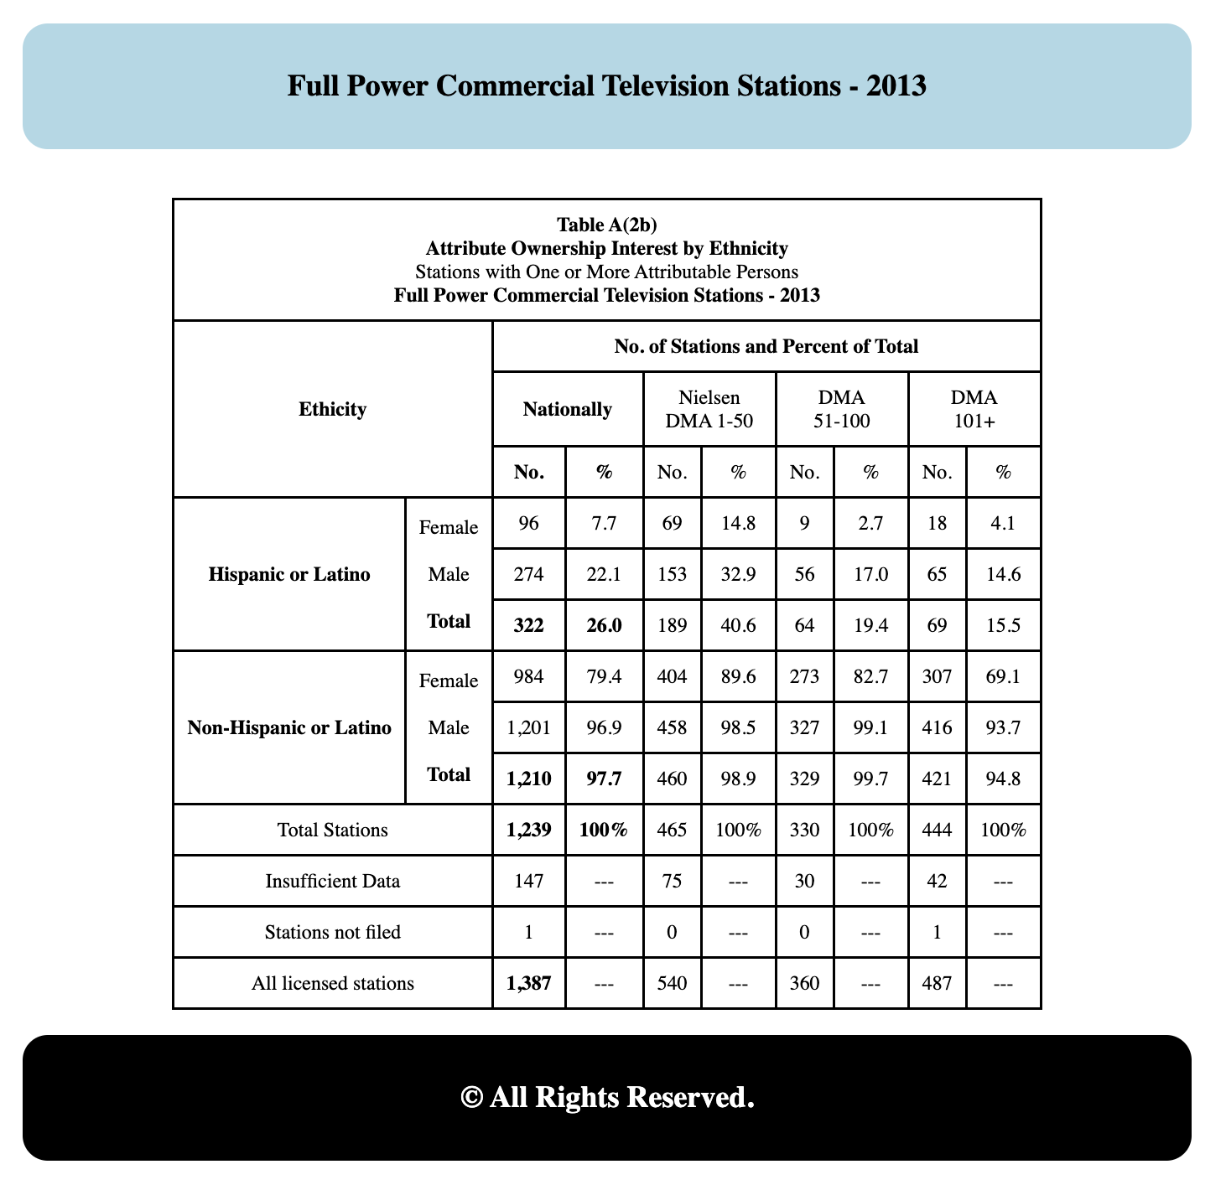
2nd Week ( 24th Jan to 26th Jan ) Tasks
25th January 2024 : On this day, a form template is given, and using CSS properties like display flex, we have to make a form.
26th January 2024 : On the next day, with the same template, we have to make the same form. Instead of using display properties, we have to use grid properties that have been taught on that day.
24th January 2024 : Introduction to tables with table properties like tr, td, thead, and many more.

Slide 12
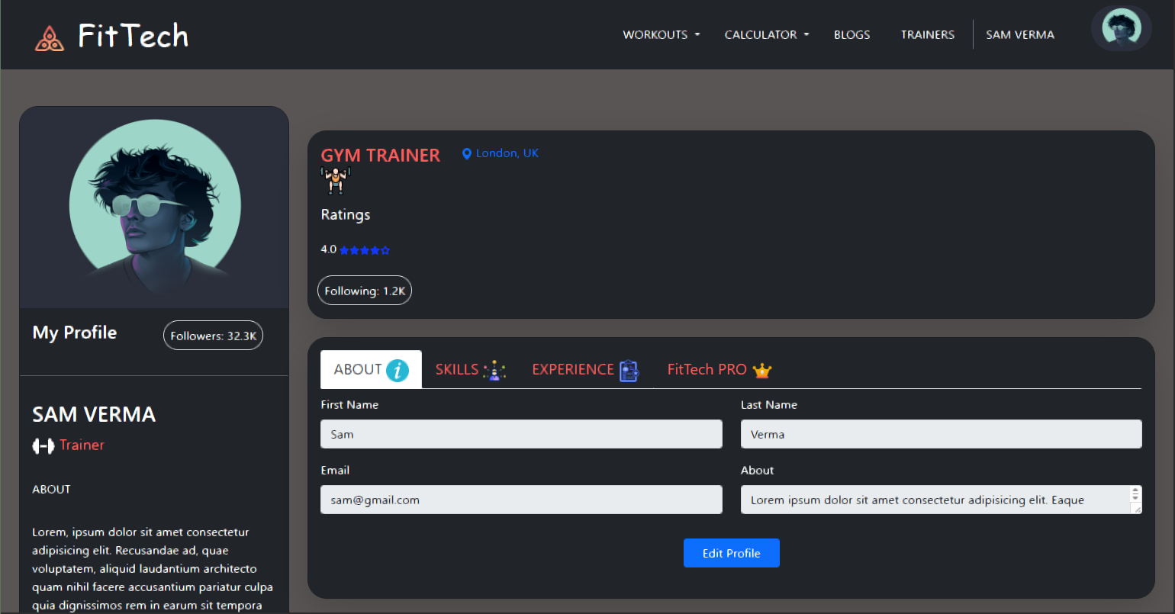
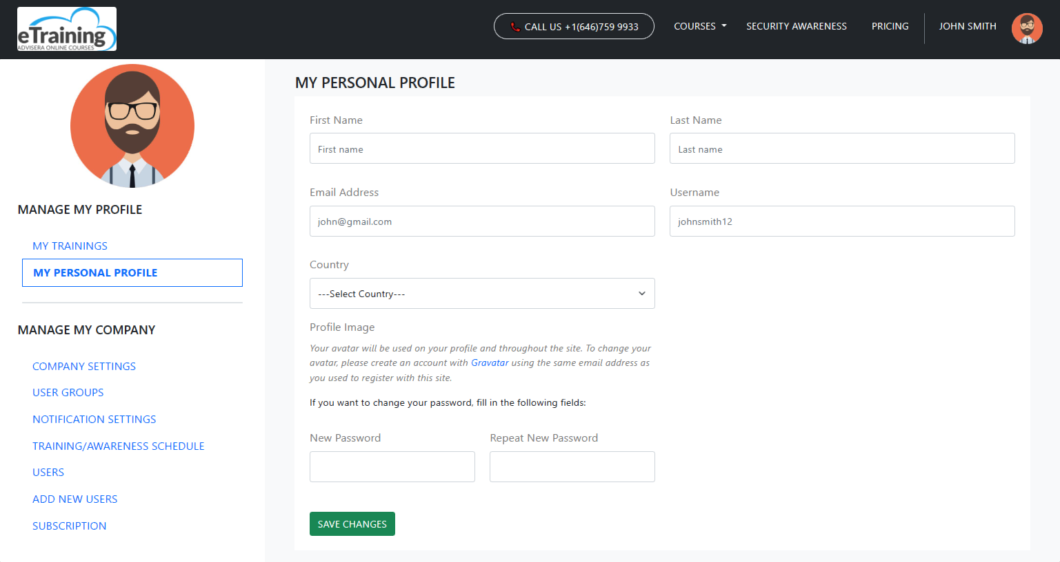
3rd WEEK TASKS ( 29th JAN to 3rd FEB )
29th January 2024 , 30th January 2024 , 31st January 2024 : So on these days, I read documentation about new CSS properties and changes implemented on previous tasks given by mentors.
1st February 2024 : As you can see in the above image, the dashboard design uses the CSS properties that have been taught until now.
2nd February 2024 , 3rd February 2024 : On these days, I have to make a dashboard in which a simple form is also included based on a simple template.

Slide 13
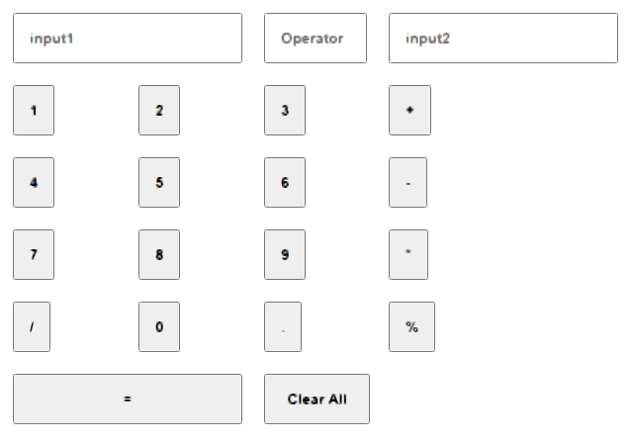
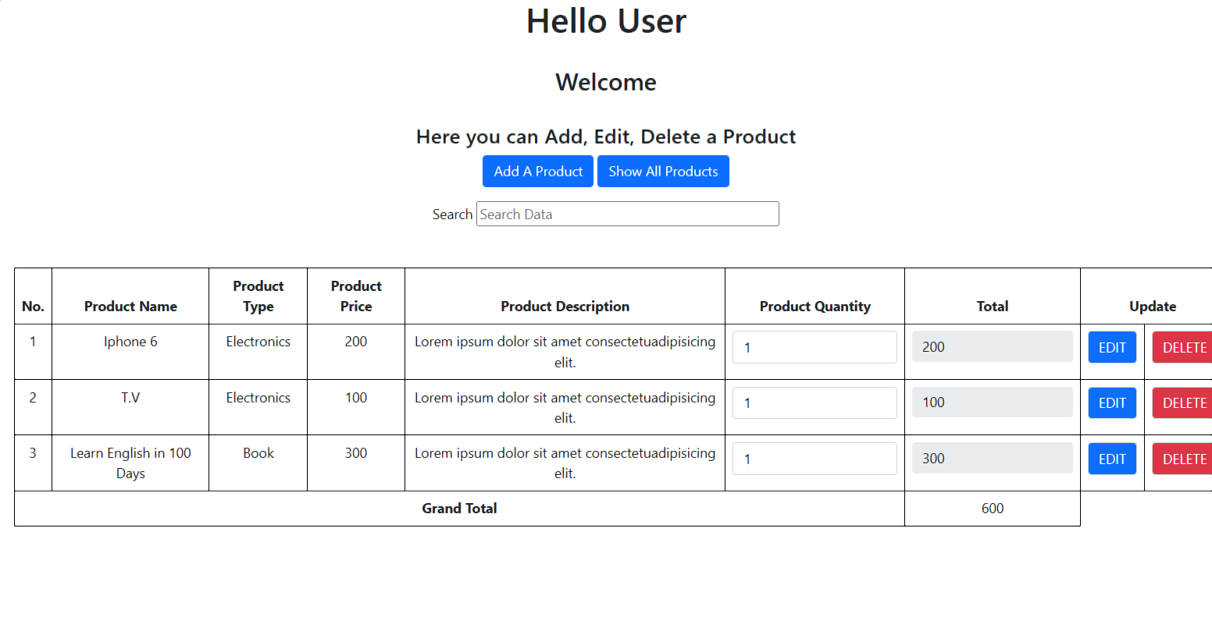
4th WEEK TASKS ( 5th FEB to 7th FEB )
6th February 2024 : On this day, normal documentation reads about a few javascript functions and changes implemented on previous tasks.
7th February 2024 : As you can see, simple crud operations are performed using an array of objects with the functionalities of sorting, filtering, and searching in JavaScript.
5th February 2024 : On this day, I was introduced to JavaScript with a simple calculator task

Slide 14
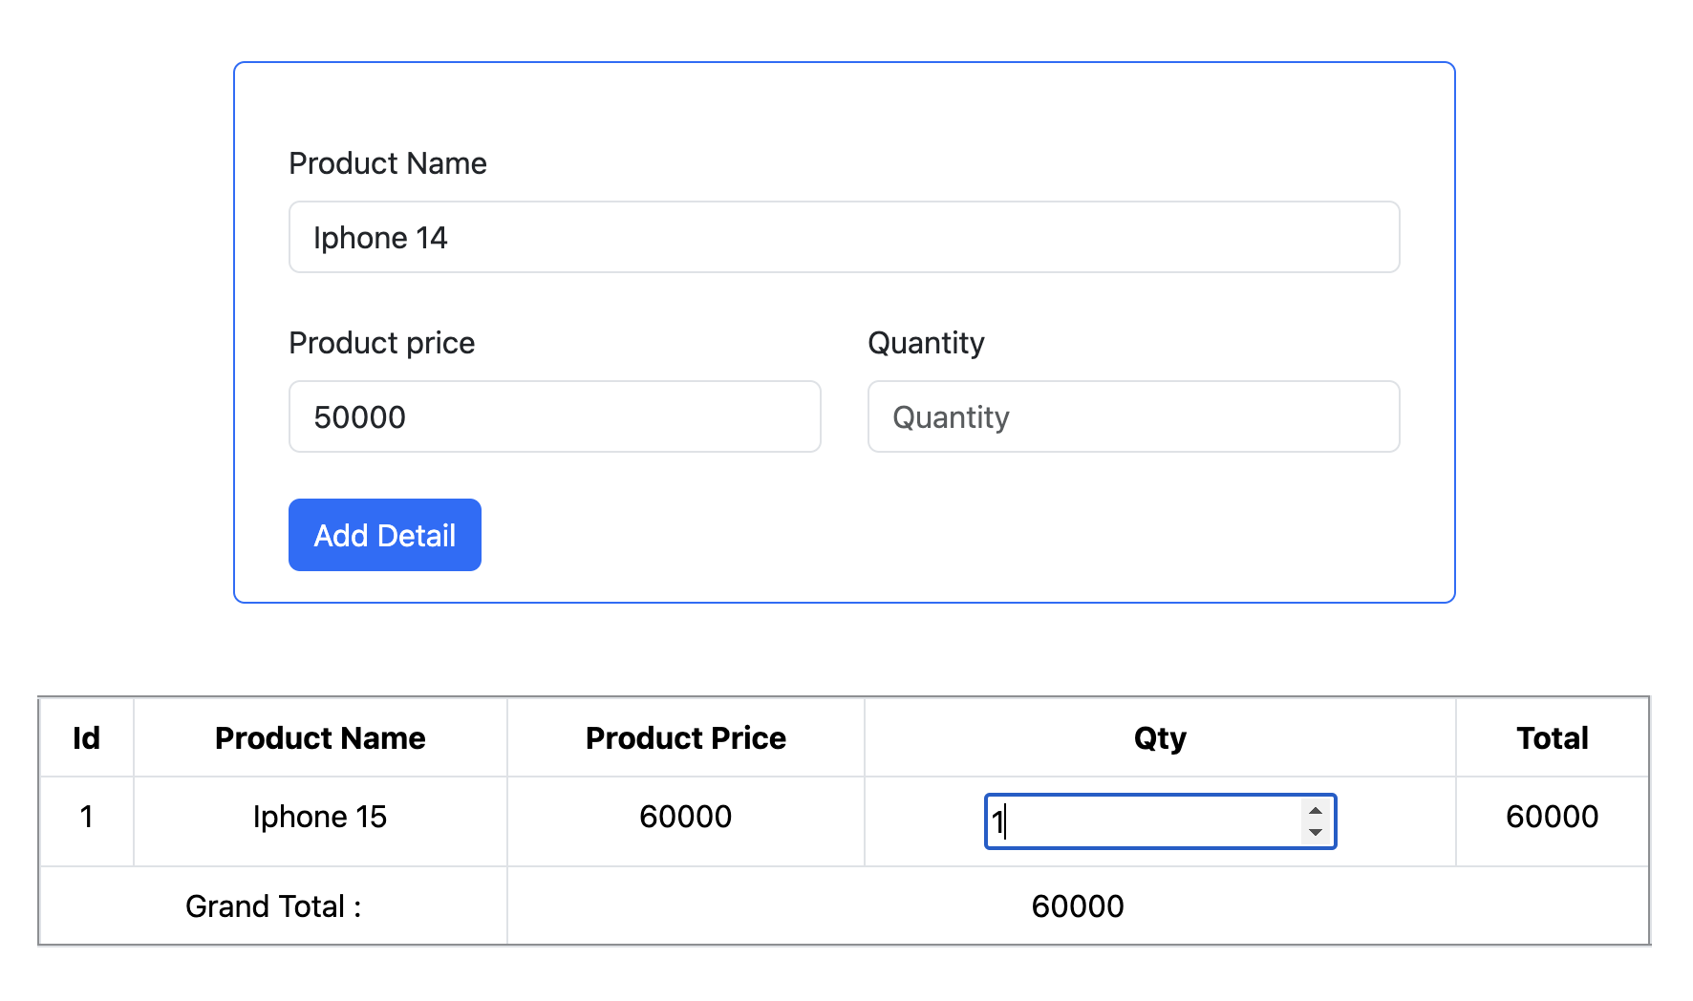
4th WEEK TASKS ( 8th FEB )
8th February 2024
On this day, as you can see in the image, the same crud operations are performed using an array of objects in JavaScript; additionally, the cart functionalities like you can change the quantity, and with changing the quantity, the total and grand total also change.

Slide 15
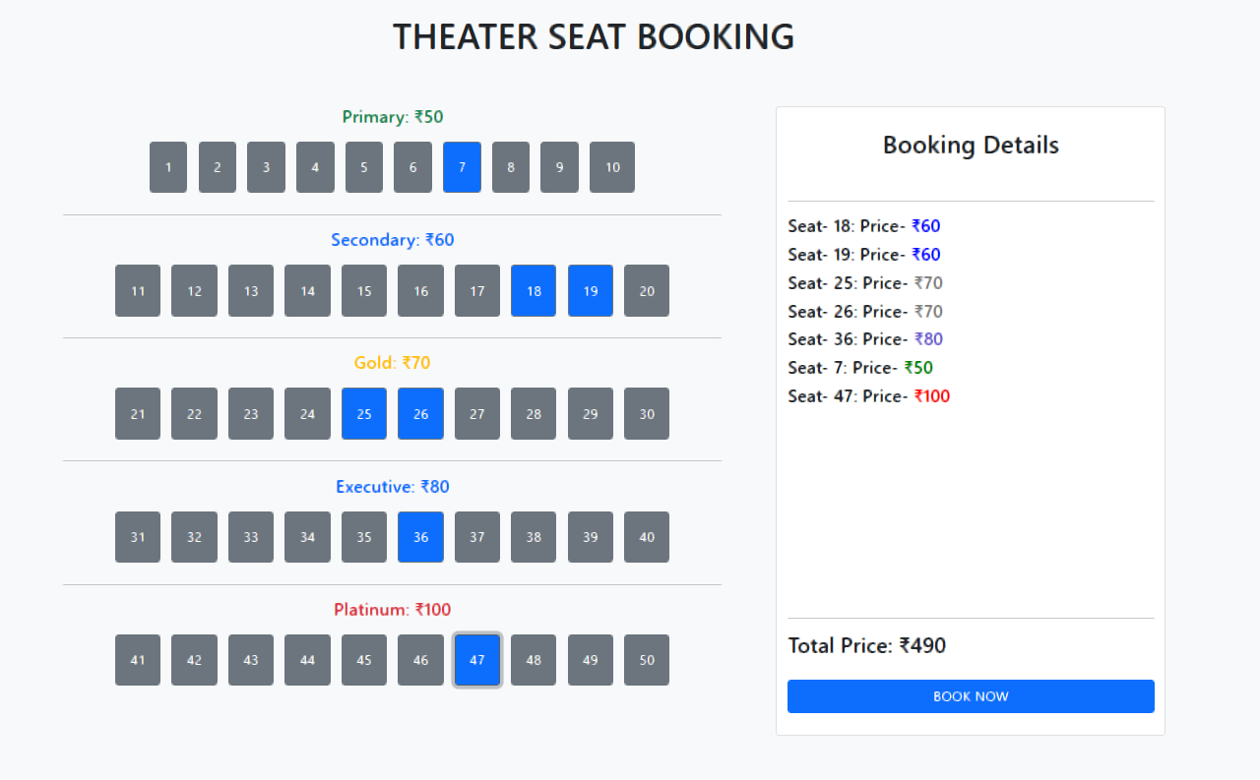
On this day, a mini-exam was given based on HTML, JavaScript, Bootstrap, and CSS. In this task, we have to create the ticket booking lookalike BookMyShow, in which, on selecting a ticket, ticket details and price are shown on the right side of the table. And after selecting the ticket and clicking on the book now button, the total ticket price should be popped up, and if not selected, and then you click on the book now button, a pop-up window will pop up, which says at least one ticket should be popped up.
4th WEEK TASKS ( 9th FEB )
9th February 2024 ( Mini Exam )

Slide 16
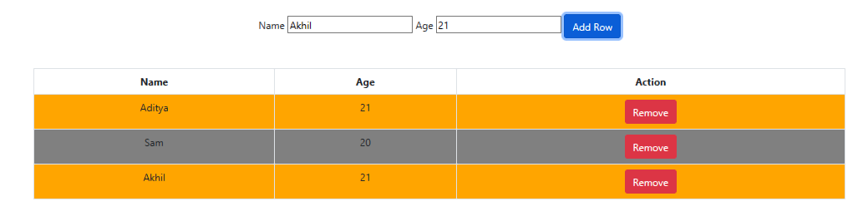
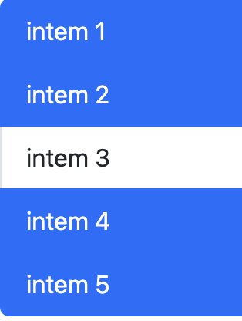
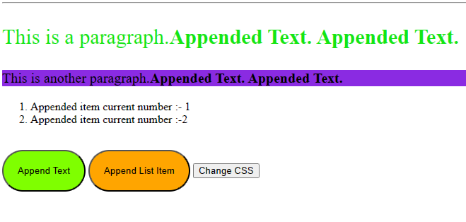
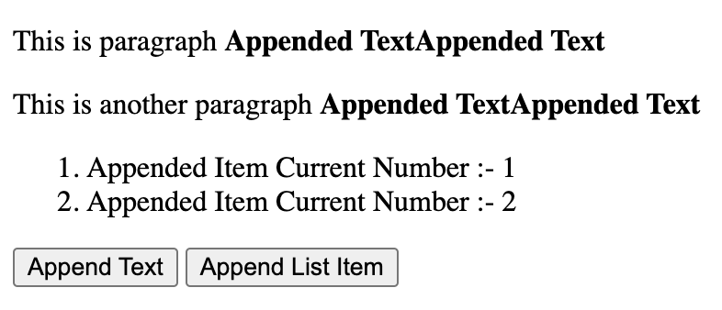
5th WEEK TASKS ( 12th FEB )
12th February 2024 : On this day, there are multiple tasks assigned in which different jQuery plugins and functions are used, like addClass, on-click events using jQuery event handling, appending data to particular tags, and many more.

Slide 17
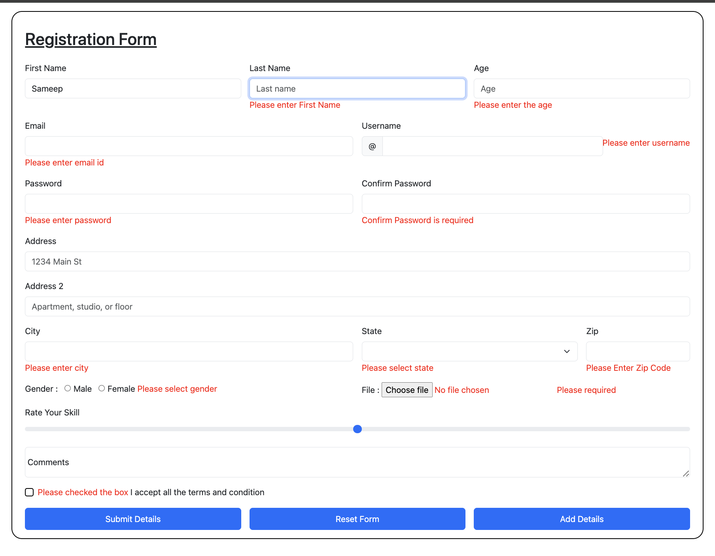
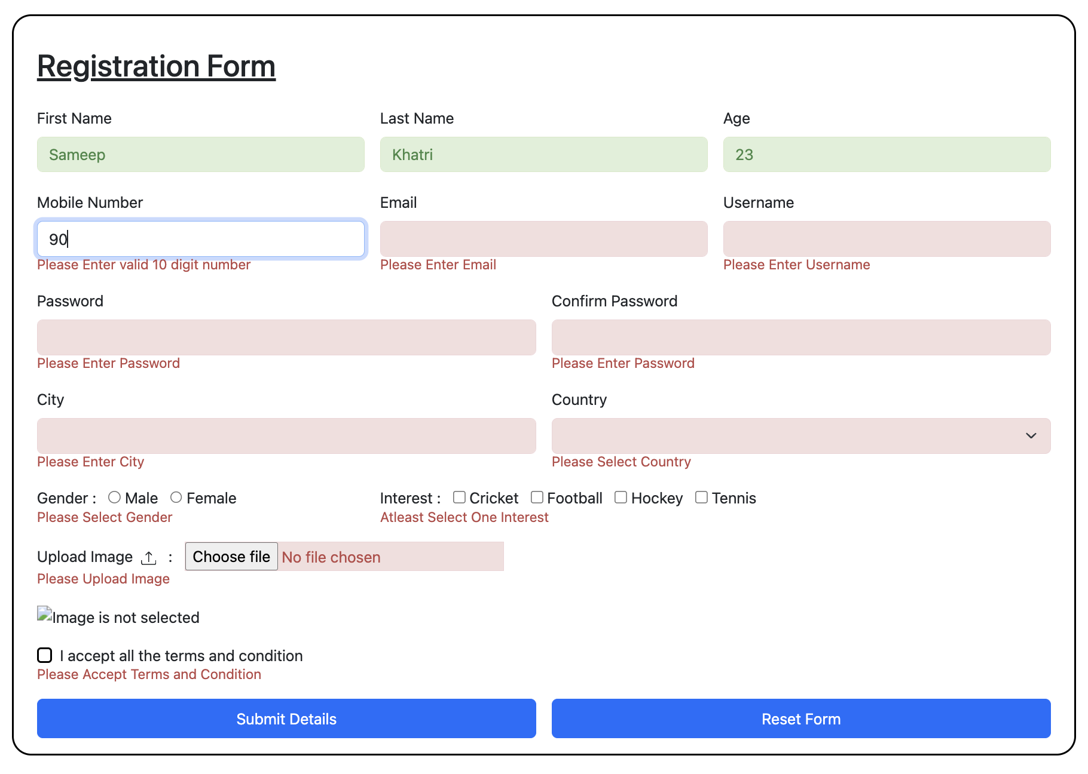
5th WEEK TASKS ( 13th FEB to 14th FEB )
13th February 2024 , 14th February 2024 : On these days, we have been taught about two different validations, which are data-parsley validation and jQuery validation. As you can see in both images, two different validations are applied.

Slide 18
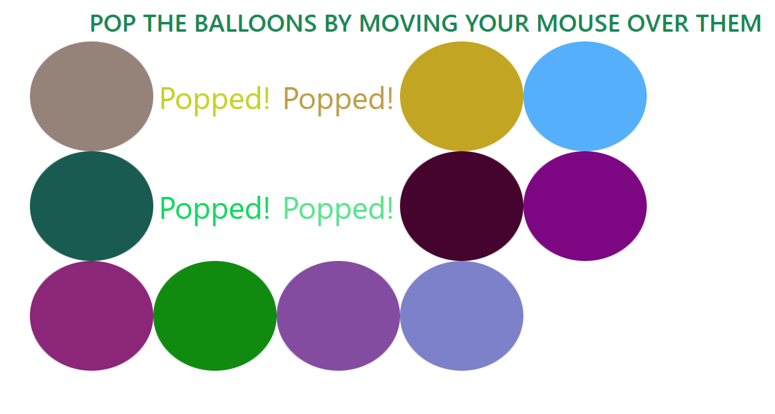
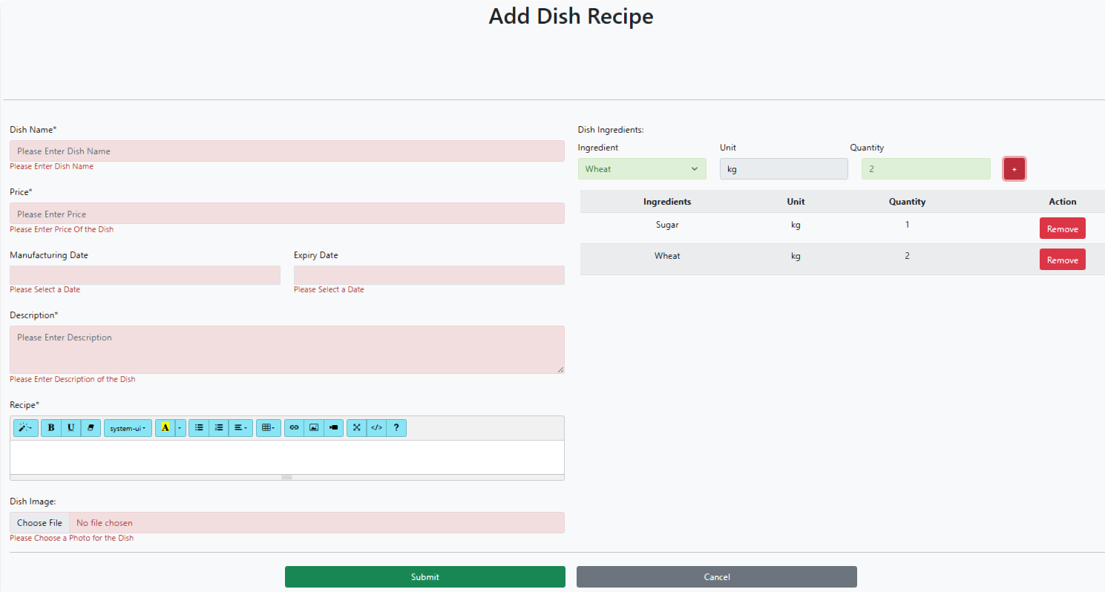
5th WEEK TASKS ( 15th FEB )
16th February 2024 : On this day, two tasks are assigned. The first one is the ballon poop game, in which a button on click will add a ballon, and a mouse over it will poop the ballon. After pooping, it will message pooped. If all balloons are pooped, then a poop-up will appear, indicating that you won the game. And the second task is to make a form based on the given template.

Slide 19
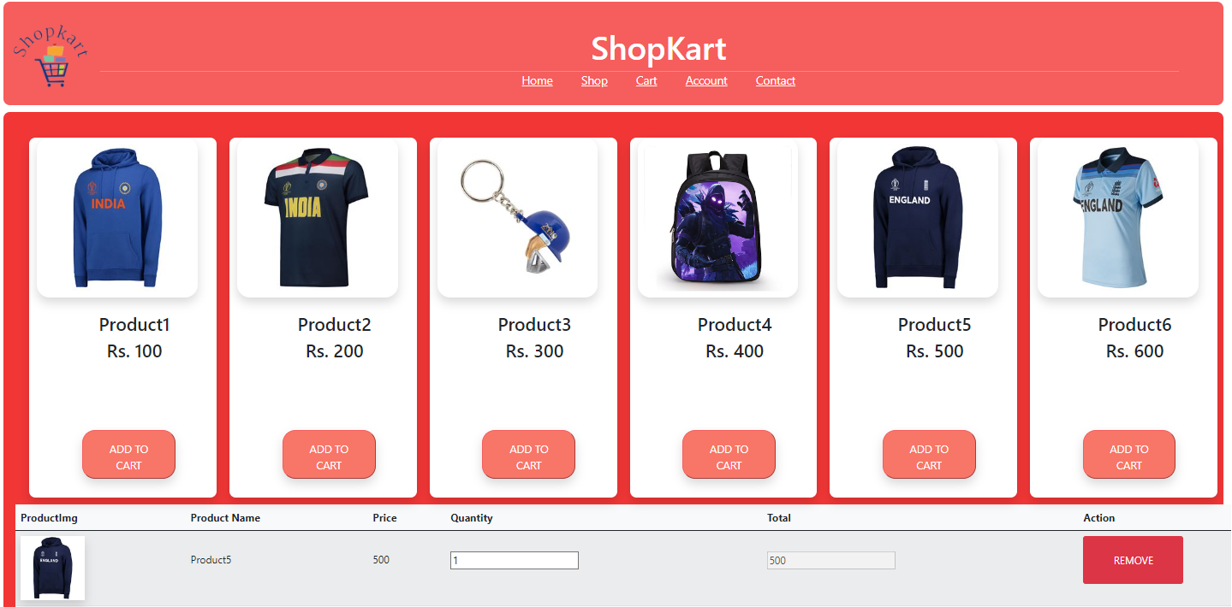
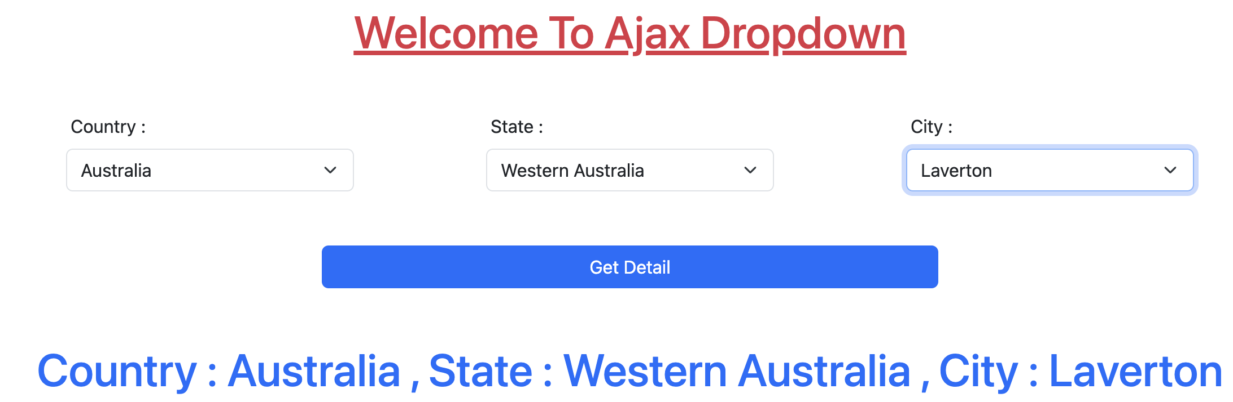
5th WEEK TASKS ( 16th FEB to 17th FEB )
16th February 2024 : On this day, as you can see in the image, I have to perform a crud operation using jQuery and fetch the data from a JSON file using jQuery Ajax.
17th February 2024 : On this day, as you can see in the image, I have to perform a listing of states, cities, and countries from a JSON file using jQuery Ajax, with the condition that after selection of that country, only that listing of states of that particular country will be displayed, as well as the same for state and city.

Slide 20
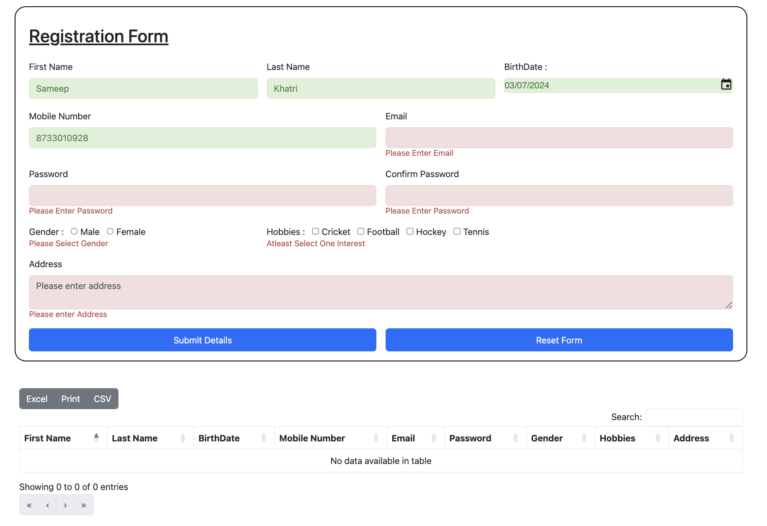
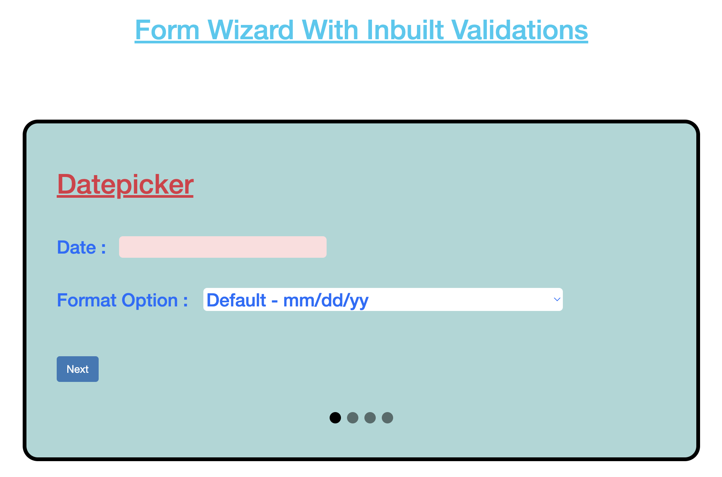
6th WEEK TASKS ( 19th FEB to 20th FEB )
19th February 2024 : As you can see in the image, a form with validation is shown with an introduction to the data-table.
20th February 2024 : On this day, an introduction to the form wizard is taught with validation, data-picker, select2, and many more jQuery plugins.

Slide 21
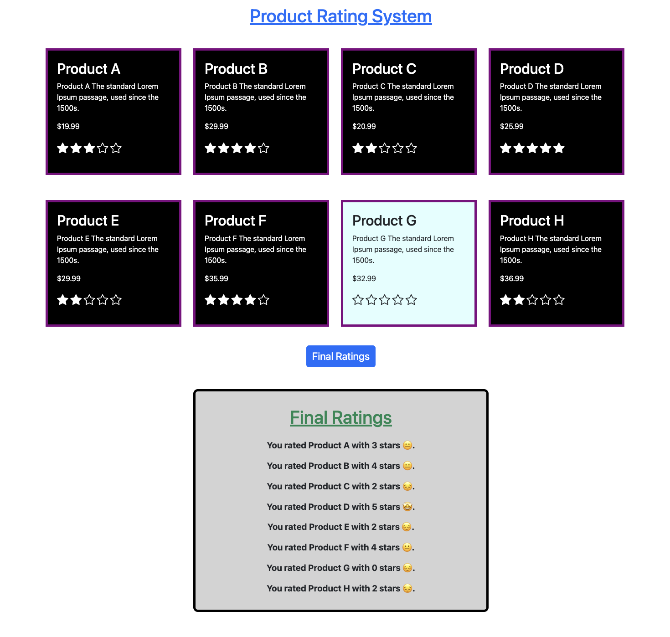
6th WEEK TASKS ( 21st FEB to 23rd FEB )
21st February 2024 : As you can see in the image on the left side, on this day the exam is conducted based on HTML, CSS, Bootstrap, JavaScript, and jQuery. So a product rating system is there in which we have to rate a product, and after rating, clicking on the final rating button, we have to show the rating of the particular product with an emoji condition. We also have to pop up a sweet-alert dialogue on the given condition.
22nd February 2024 , 23rd February 2024 : On these days, introduction to the database with relations, database components, data types, and many more. And I have to make Excel sheets of the databases on the basis of the given flowchart.

Slide 22
2nd March 2024
7th Week Tasks ( 26th Feb to 2nd Mar )
26th February 2024
27th February 2024
28th February 2024
On this day,I started with the database, in which I understand string functions and numbers functions, select a query with different condition groups by and having condition.
On that day, I continued learning about the date function, different types of joins like self-join, inner-join, right-join, left-join, and different types of date formats in SQL.
On this day, I learned subquery, case query, and limit in SQL. I also performed some queries on it.
29th February 2024
1st March 2024
On this day, I understood how to create a database for any showcase. In that, how do you give the primary key, foreign key, unique key, and which fields to use in the table?
On that day, I did the task of the bathroom showcase for the application. We created the database for that showcase, applied triggers to the database, and created queries accordingly.
On that day, I learned triggers in the database and normalised the different tables in the database.

Slide 23
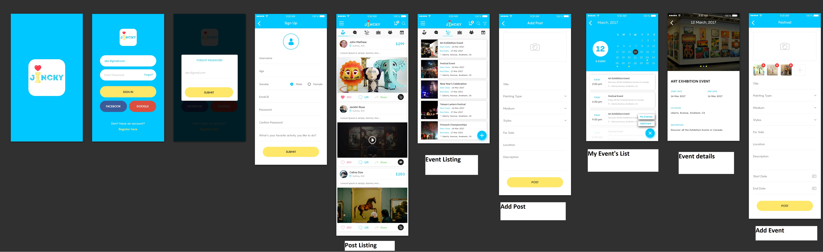
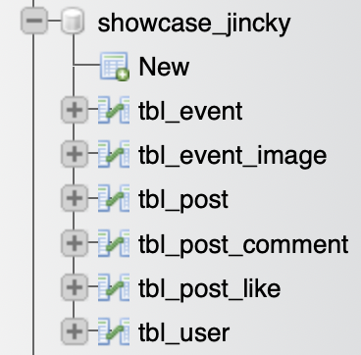
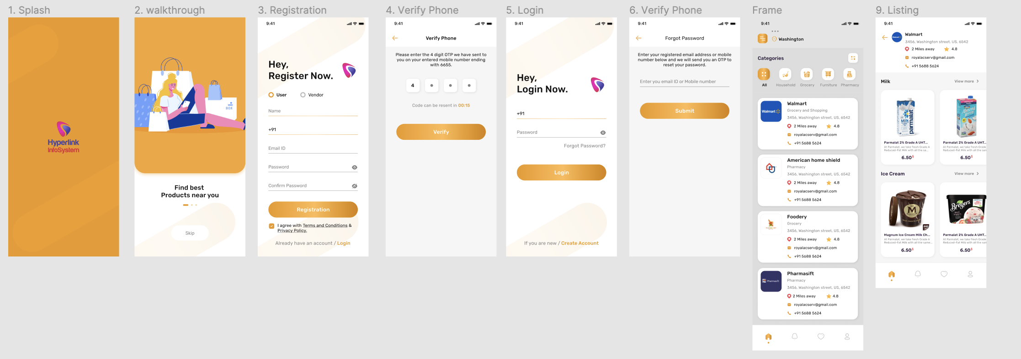
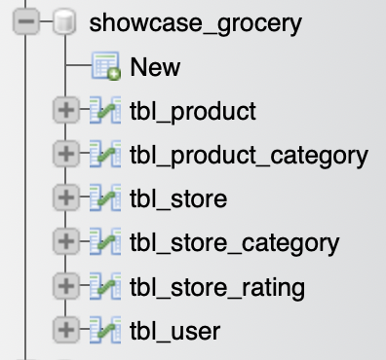
8th WEEK TASKS ( 4th March to 5th March )
4th March 2024 , 5th March 2024 : On these days, we have been given showcases of particular apps, and based on that, we have to create databases and write queries. On the left side is the show case, and on the right side is the database showing the tables included in it.

Slide 24
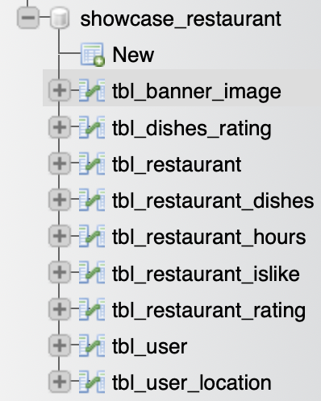
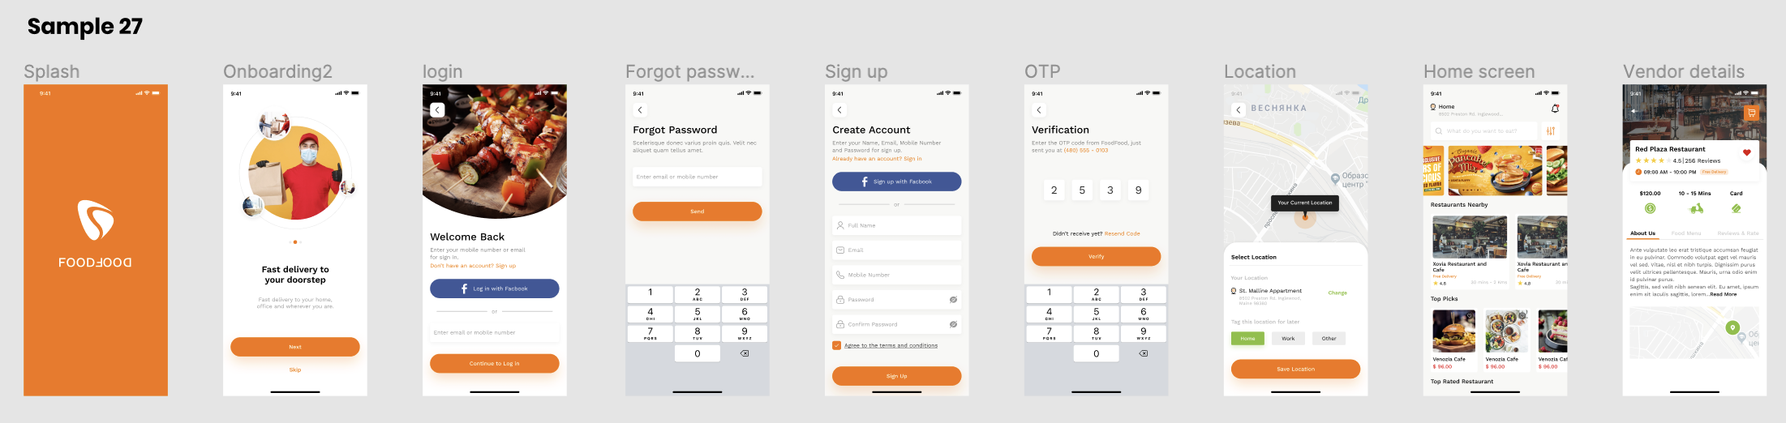
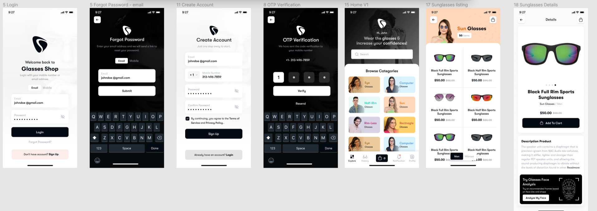
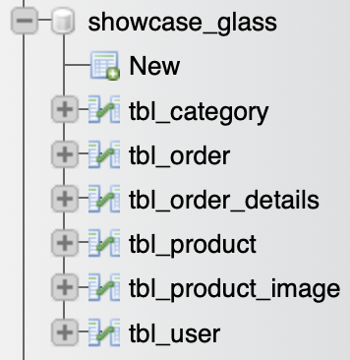
8th WEEK TASKS ( 6th March to 8th March )
6th March 2024 , 7th March 2024 , 8th March 2024 : Similar to the previous slide, we showcase the app, and we have to make databases and write queries for it.

Slide 25
THANK YOU!
hAvE a GoOd Day !!

